Slide 1
Design Notes
These slides are hidden, and will not display when presenting.
You’re welcome to delete these slides if you plan to share your deck.

Slide 2
Sharing
You are responsible for sharing your deck, your code, or anything else you like.
You can use Sched.com, or you can use another location. It’s entirely up to you.
We suggest including a shortened URL at the end of the presentation.

Slide 3
Demos
Please modify console, ISE, or VS Code colors to use a high-contrast color scheme.
“Light” themes often work better, especially when combined with bold fonts and dark text colors.
Jack up the font size so your code is legible at the back of the room.

Slide 4
Demos
We strongly recommend the use of VS Code – all attendees can get it, and we’d like them to get used to it
We recommend the Light+ theme
Use the Zoom feature to raise the font size consistently throughout the UI

Slide 5
Copyright
Please do not include graphics or videos you found on the Internet unless you have explicit permission from their owner to use them.
We have had take-down notices in the past and would like to avoid this.
When in doubt, skip the silly picture.

Slide 6
Copyright
We default slides to a Creative Commons attribution, sharealike, noncommercial license
You’re welcome to state a different copyright policy. If you do, please remove the CC logos.

Slide 7
Lastly
Please leave the boilerplate slide at the end of the presentation, and leave it on-screen as you end.
During your “Final Q&A” is a good time to bring that slide up.

Slide 8


Deep Web: A Web Cmdlets Deep Dive
By Mark Kraus

Slide 9
Agenda
The Man Behind the Rin Avatar
Why Web Cmdlets?
WebListener and Web Cmdlet Testing
Differences form 5.1 to 6+
Authentication
Sessions and Cookies
Cmdlet Internals
Web Scraping

Slide 10

Who is Mark Kraus?
Senior Systems Engineer at LinkedIn
Author of Get-PowerShellBlog
PowerShell Core Project Collaborator
Web Cmdlets Contributor
PowerShell Live Coordinator
markekraus pretty much everywhere

Slide 11
Why Web Cmdlets?
IT Has Changed
REST Rules the World
Lightning Demos Featured 2 REST API Wrappers
Clouds run on REST
PaaS and Serverless run on REST
Your thermostat runs on REST
Notes:
PowerShell Core is cross platform and that means IE is not available everywhere. Internet Explorer was used for HTML parsing. That means we no longer have anything but basic html parsing available.
The good news is that the IE integration was a major pain in headless automation. You either needed to ensure –UseBasicParsing was present or login as the service account and perform first run configuration for IE.
HTTP and HTTPS are now the only supported protocols. No more FILE:// and FTP:// support. This may be problematic. FILE support is probably not a loss as you could use get-content, but no FTP support may be painful.
.NET Core dropped SSL 3.0 support. Now only TLS 1.0, 1.1, and 1.2 are supported.

Slide 12
WebListener and Web Cmdlet Testing
WebListener is an ASP.NET Core Kestrel Server
In-CI Cross-Platform Testing
200+ Pester Tests for Web Cmdlets
Used in demos
Notes:
PowerShell Core is cross platform and that means IE is not available everywhere. Internet Explorer was used for HTML parsing. That means we no longer have anything but basic html parsing available.
The good news is that the IE integration was a major pain in headless automation. You either needed to ensure –UseBasicParsing was present or login as the service account and perform first run configuration for IE.
HTTP and HTTPS are now the only supported protocols. No more FILE:// and FTP:// support. This may be problematic. FILE support is probably not a loss as you could use get-content, but no FTP support may be painful.
.NET Core dropped SSL 3.0 support. Now only TLS 1.0, 1.1, and 1.2 are supported.

Slide 13
Start WebListener Start-WebListener.ps1
Notes:
Demo consists of working with another person on a function using VS Code Live Share.
NOTE: This is a basic “hello world” function and does not show any proprietary code of any kind. The focus is not the code but rather how to use the VS Code Live Share feature.

Slide 14
Differences from 5.1 to 6.0
No more Internet Explorer Integration
Basic HTML Parsing Only (no ParsedHtml access)
HTTP and HTTPS Only
No SSL 3.0 support
Notes:
PowerShell Core is cross platform and that means IE is not available everywhere. Internet Explorer was used for HTML parsing. That means we no longer have anything but basic html parsing available.
The good news is that the IE integration was a major pain in headless automation. You either needed to ensure –UseBasicParsing was present or login as the service account and perform first run configuration for IE.
HTTP and HTTPS are now the only supported protocols. No more FILE:// and FTP:// support. This may be problematic. FILE support is probably not a loss as you could use get-content, but no FTP support may be painful.
.NET Core dropped SSL 3.0 support. Now only TLS 1.0, 1.1, and 1.2 are supported.

Slide 15
Basic Parsing Only Demo 01-BasicParsingOnly.ps1
Notes:
Demo consists of working with another person on a function using VS Code Live Share.
NOTE: This is a basic “hello world” function and does not show any proprietary code of any kind. The focus is not the code but rather how to use the VS Code Live Share feature.

Slide 16
HTTPS and Certificate Validation
6+ Does not support ServicePointManager
6+ Has -SkipCertificateCheck
5 and older require ServerCertificateValidationCallback
5 and older require TLS 1.2 to be enabled
6+ Supports TLS 1.2 without any configuration changes
6+ Has no custom validation support
Notes:
PowerShell Core is cross platform and that means IE is not available everywhere. Internet Explorer was used for HTML parsing. That means we no longer have anything but basic html parsing available.
The good news is that the IE integration was a major pain in headless automation. You either needed to ensure –UseBasicParsing was present or login as the service account and perform first run configuration for IE.
HTTP and HTTPS are now the only supported protocols. No more FILE:// and FTP:// support. This may be problematic. FILE support is probably not a loss as you could use get-content, but no FTP support may be painful.
.NET Core dropped SSL 3.0 support. Now only TLS 1.0, 1.1, and 1.2 are supported.

Slide 17
HTTPS Demos 02-ServicePointManager.ps1 03-SkipCertificateCheck.ps1 04-TLS-1.2.ps1
Notes:
Demo consists of working with another person on a function using VS Code Live Share.
NOTE: This is a basic “hello world” function and does not show any proprietary code of any kind. The focus is not the code but rather how to use the VS Code Live Share feature.

Slide 18
WebRequest to HttpClient
5 and older use System.Net.WebRequest
6+ uses System.Net.Http.HttpClient
Mostly unchanged from PowerShell user perspective
Subtle differences
Notes:
PowerShell Core is cross platform and that means IE is not available everywhere. Internet Explorer was used for HTML parsing. That means we no longer have anything but basic html parsing available.
The good news is that the IE integration was a major pain in headless automation. You either needed to ensure –UseBasicParsing was present or login as the service account and perform first run configuration for IE.
HTTP and HTTPS are now the only supported protocols. No more FILE:// and FTP:// support. This may be problematic. FILE support is probably not a loss as you could use get-content, but no FTP support may be painful.
.NET Core dropped SSL 3.0 support. Now only TLS 1.0, 1.1, and 1.2 are supported.

Slide 19
Invoke-WebRequest Response Differences
6+ Header Values are arrays
5 and older BaseResponse property is HttpWebResponse
6+ BaseResponse property is HttpResponseMessage
Notes:
PowerShell Core is cross platform and that means IE is not available everywhere. Internet Explorer was used for HTML parsing. That means we no longer have anything but basic html parsing available.
The good news is that the IE integration was a major pain in headless automation. You either needed to ensure –UseBasicParsing was present or login as the service account and perform first run configuration for IE.
HTTP and HTTPS are now the only supported protocols. No more FILE:// and FTP:// support. This may be problematic. FILE support is probably not a loss as you could use get-content, but no FTP support may be painful.
.NET Core dropped SSL 3.0 support. Now only TLS 1.0, 1.1, and 1.2 are supported.

Slide 20
Invoke-RestMethod Response Headers
-ResponseHeadersVariable parameter
Creates variable
Same object as Headers property on Invoke-WebRequest

Slide 21
Header Values Demo 05-HeaderValues.ps1
Notes:
Demo consists of working with another person on a function using VS Code Live Share.
NOTE: This is a basic “hello world” function and does not show any proprietary code of any kind. The focus is not the code but rather how to use the VS Code Live Share feature.

Slide 22
Error Handling
Error Output Improvements
Exception.Response is a different type
No Access to Raw response in 6+
Any non-200 level response treated as an error
Notes:
PowerShell Core is cross platform and that means IE is not available everywhere. Internet Explorer was used for HTML parsing. That means we no longer have anything but basic html parsing available.
The good news is that the IE integration was a major pain in headless automation. You either needed to ensure –UseBasicParsing was present or login as the service account and perform first run configuration for IE.
HTTP and HTTPS are now the only supported protocols. No more FILE:// and FTP:// support. This may be problematic. FILE support is probably not a loss as you could use get-content, but no FTP support may be painful.
.NET Core dropped SSL 3.0 support. Now only TLS 1.0, 1.1, and 1.2 are supported.

Slide 23
Error Handling Demo 06-ErrorHandling.ps1
Notes:
Demo consists of working with another person on a function using VS Code Live Share.
NOTE: This is a basic “hello world” function and does not show any proprietary code of any kind. The focus is not the code but rather how to use the VS Code Live Share feature.

Slide 24
Authentication
-Authentication added in 6.0.0
None – Default
Basic – Requires -Credential
OAuth – Requires -Token
Authentication over non-HTTPS not allowed by default
Use –AllowUnencryptedAuthentication to bypass
Notes:
PowerShell Core is cross platform and that means IE is not available everywhere. Internet Explorer was used for HTML parsing. That means we no longer have anything but basic html parsing available.
The good news is that the IE integration was a major pain in headless automation. You either needed to ensure –UseBasicParsing was present or login as the service account and perform first run configuration for IE.
HTTP and HTTPS are now the only supported protocols. No more FILE:// and FTP:// support. This may be problematic. FILE support is probably not a loss as you could use get-content, but no FTP support may be painful.
.NET Core dropped SSL 3.0 support. Now only TLS 1.0, 1.1, and 1.2 are supported.

Slide 25
Authentication Demos 07-BasicAuth.ps1 08-OAuth.ps1
Notes:
Demo consists of working with another person on a function using VS Code Live Share.
NOTE: This is a basic “hello world” function and does not show any proprietary code of any kind. The focus is not the code but rather how to use the VS Code Live Share feature.

Slide 26
Cookies and Sessions
-SessionVariable creates a variable
-WebSession consumes that variable
Add and retrieve headers and cookies

Slide 27
Session Demo 09-Sessions.ps1

Slide 28
Web Cmdlet Internals
HttpClient and HttpClientHandler APIs
WebRequestPSCmdlet Base Class
Invoke-RestMethod: InvokeRestMethodCommand dervived class
Invoke-WebRequest: InvokeWebRequestCommand derived class

Slide 29
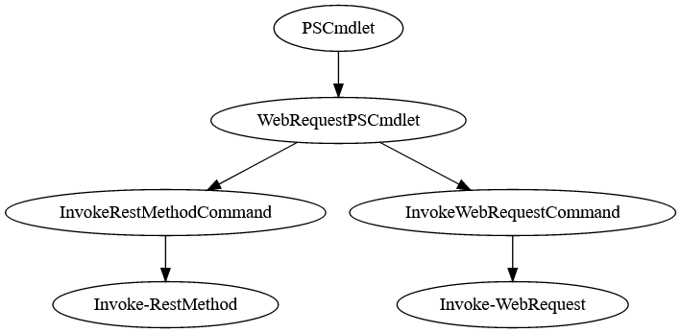

Slide 30
WebRequestPSCmdlet
ProcessRecord() for both cmdlets
Order of Operations:
Validate Params
Prepare Session
Process Authentication Settings
Create HttpRequestMessage
Set Body Contents

Slide 31
WebRequestPSCmdlet
Check for success
Create errors (if not successful)
ProcessResponse()
Retry or follow links

Slide 33
Invoke-WebRequest
If text response
Attempts Basic HTML Parsing
Returns BasicHtmlWebResponseObject
If not text (image, binary, etc)
Returns WebResponseObject
Writes to a file if -OutFile specified

Slide 34
Invoke-WebRequest Internals
WebRequestPSCmdlet.ProcessRecord()
InvokeWebRequestCommand.ProcessResponse()
StreamHelper.GetResponseStream()
WebResponseContentMemoryStream
WebResponseObjectFactory.GetResponseObject()
StreamHelper.SaveStreamToFile()

Slide 35
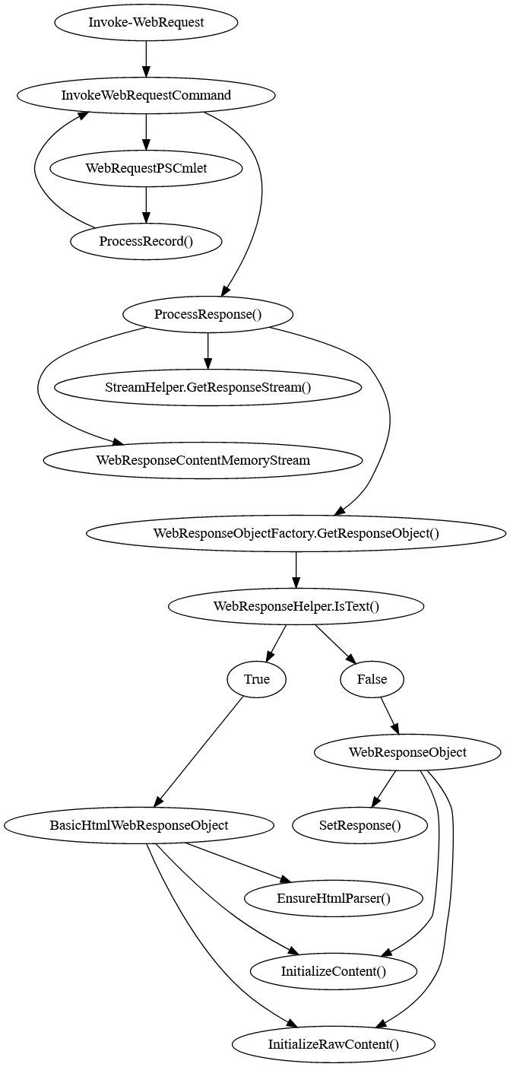

Slide 36
Invoke-RestMethod
Tries to parse as Atom/RSS
Tries to parse as JSON
Tries to parse as XML
Returns a string if all else fails.
Writes to a file if -OutFile specified

Slide 37
Invoke-RestMethod Internals
WebRequestPSCmdlet.ProcessRecord()
InvokeRestMethodCommand.ProcessResponse()
TryProcessFeedStream()
StreamHelper.GetResponseStream()
CheckReturnType()
StreamHelper.TryGetEncoding()
StreamHelper.DecodeStream()
TryConvertToJson()
TryConvertToXml()

Slide 38
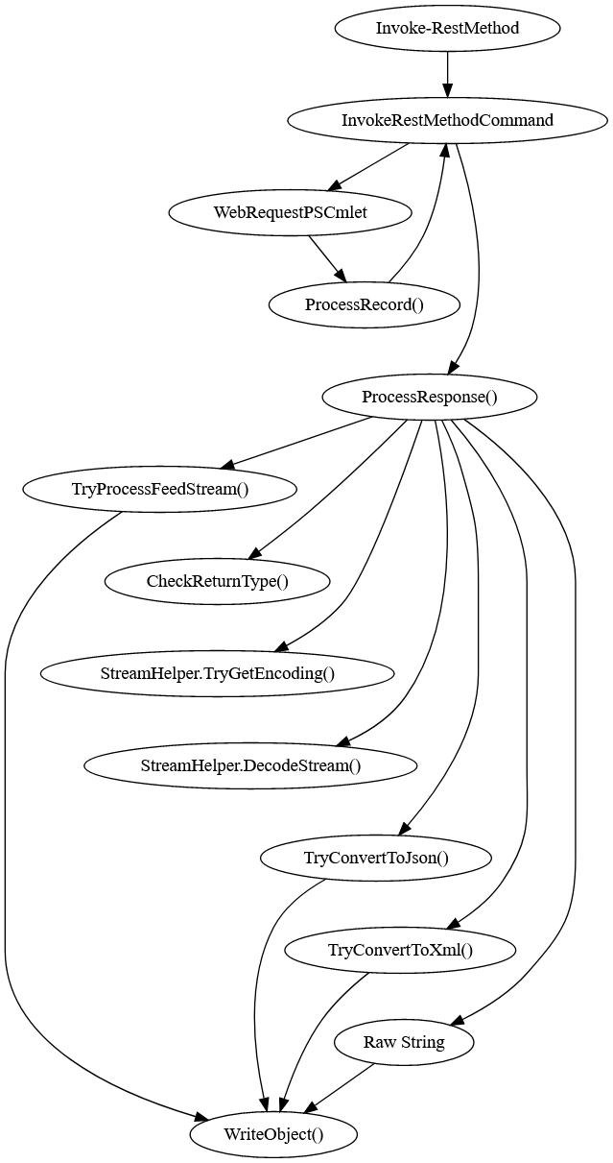

Slide 39
Under The Hood Demo

Slide 40
Web Scraping
Take HTML page and turn it into useable data
Useful when API unavailable
May break site’s Terms of Use
Could result in account/IP bans

Slide 41
Web Scraping
Requires knowledge of HTML
May not work well with JavaScript heavy apps
Requires knowledge of the page’s contents
Will likely break on subsequent content changes

Slide 42
Web Scrape Demo 10-WebScrape.ps1

Slide 43
The Future
Swagger/OpenAPI + JSON:API
AutoRest
Separation from Core?
Improved language and encoding support
MORE BUGS!!!!
ConvertFrom-HTML?
Invoke-Download?

Slide 44
Links and Attribution
Presentation Material
http://bit.ly/WebCmdletPrezo
https://github.com/markekraus/Deep-Web-Web-Cmdlets-Presentation
Attribution
Rin Avatar:
CC BY-NC-ND 3.0
https://www.katawa-shoujo.com/about.php

